Slide 1
Lending Club Case Study
Leveraging EDA techniques to understand how consumer attributes and loan attributes influence the tendency of default.
Parijat Banerjee
August 2024

Slide 2
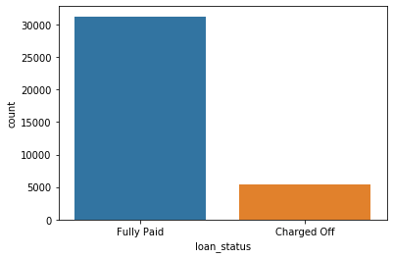
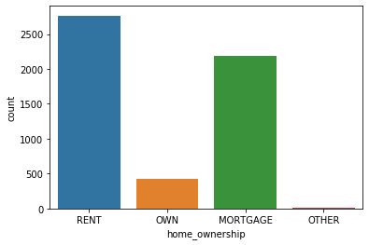
Exploratory Data Analysis
The Charged off loans counts for ~15% of the Completed loans base which is in line with expectations. The current loans which are running has been excluded from the analysis
Customers with fixed outgoings for accommodation like rent and mortgage have higher chances of default

Slide 3
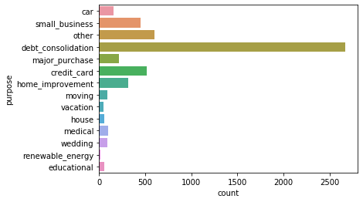
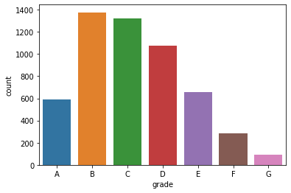
Exploratory Data Analysis
Customers who have taken loans for Debt Consolidation or Credit card or Small business have higher default propensity
Customers with grades B or C have higher chances of default

Slide 4
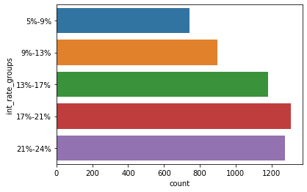
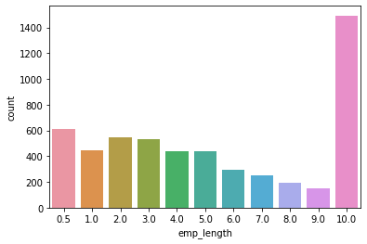
Exploratory Data Analysis
Customers who have taken higher interest loans have higher chances of default
Customers with 10yrs experience have steep spike in default

Slide 5
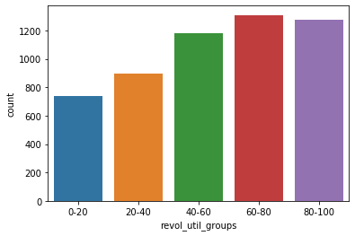
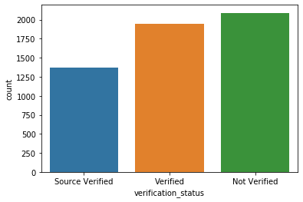
Exploratory Data Analysis
Customers with higher utilization has higher chances of default
As expected, unverified applications have higher default chances

Slide 6
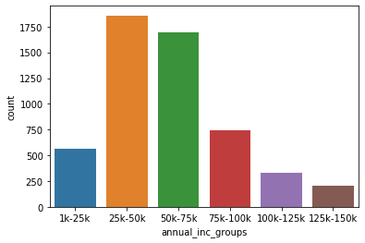
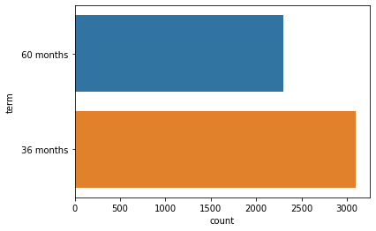
Exploratory Data Analysis
Mid income segment 25-75k has been hit hard in terms of default
Short term loans have higher default chances

Slide 7
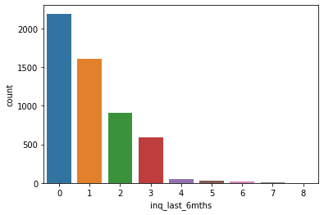
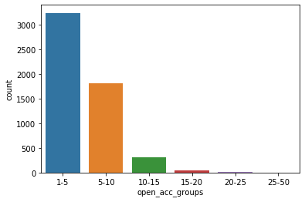
Exploratory Data Analysis
Surprisingly customers with fewer income have more default chances
More defaults have been seen for customers with fewer open accounts thereby indicating generally good customers have come under financial stress

Slide 8
Exploratory Data Analysis
Surprisingly customers with fewer income have more default chances
More defaults have been seen for customers with fewer open accounts thereby indicating generally good customers have come under financial stress

Slide 9
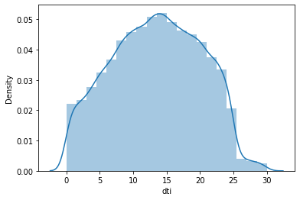
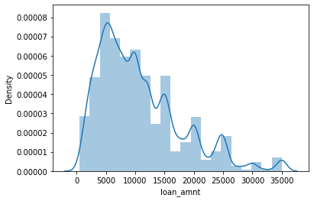
Exploratory Data Analysis
Customers with ~15% DTI have highest default chances
Loans between 5000 to 10000 has higher chances of default

Slide 10
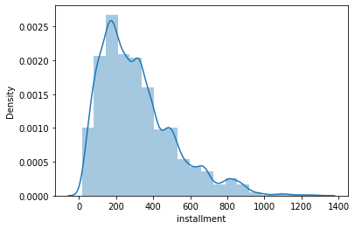
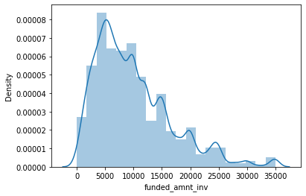
Exploratory Data Analysis
Customers < $400 installment have higher default chances
Investor funds below $12,000 have higher default

Slide 11
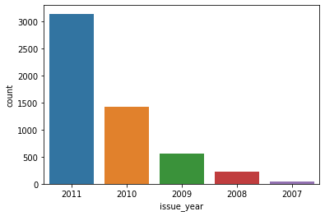
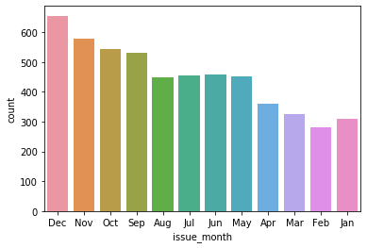
Exploratory Data Analysis
Loans issued in 4Q have higher default propensity, with 2011 being the year where a large majority of the defaulted loans were offered

Slide 12
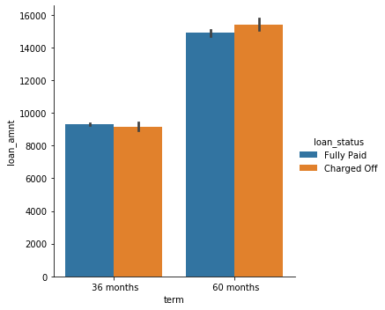
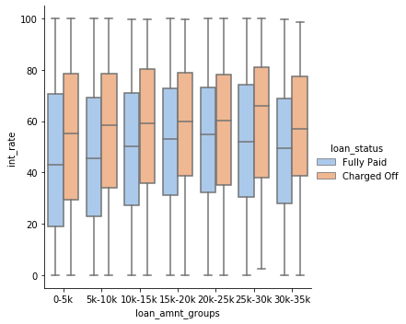
Exploratory Data Analysis
Loan amount doesn't play a role in default, Higher ticket loans have longer term
Charged off loans have higher Interest rates compared to fully paid ones in every loan segment

Slide 13
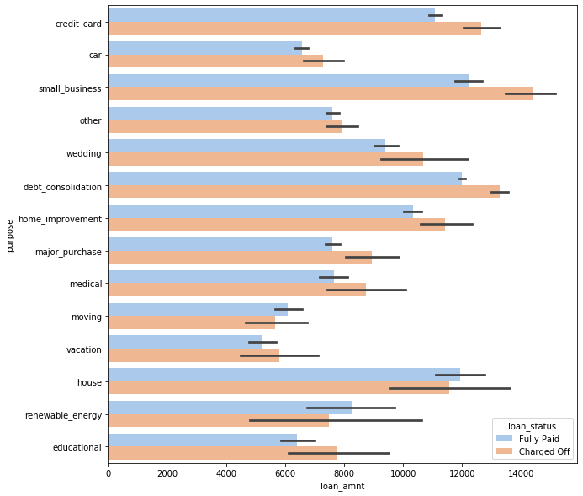
Exploratory Data Analysis
Customers where loan purpose small business and the loan amount is greater than 14k

Slide 14
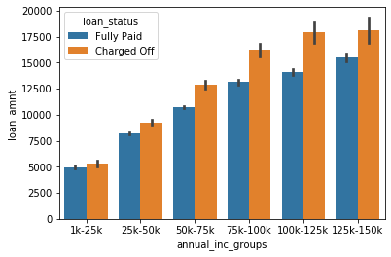
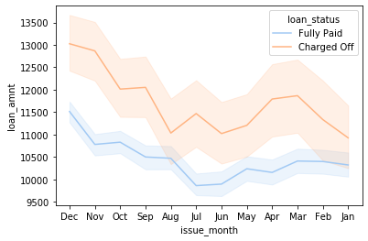
Exploratory Data Analysis
Higher Income groups have received higher ticket loans have higher default propensity
Loans issues in 4Q have higher default which is due to surge in credit requirement in Nov/Dec due to festive season

Slide 15
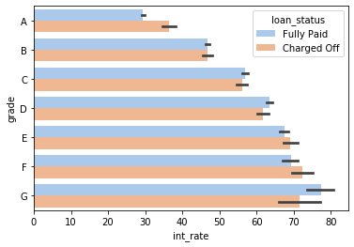
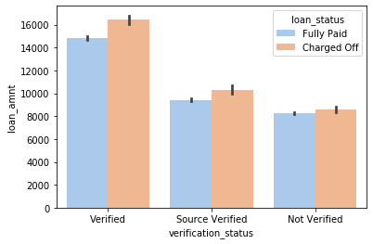
Exploratory Data Analysis
Grade G loans with highest interest rates have higher default chances
Verified Application with big loan sizes have higher chances of default. Possibility of willful default is high in this case as big-ticket loans are issued to customers with higher income and credit worthiness

Slide 16
Conclusion
Some of the Key drivers for default:
DTI
Loan Interest Rates
Term of Loan
Purpose
Income segment
Timing of application [4Q]
Customer with 10yr experience

